Slide 1
A Review of Interaction Techniques for Immersive Environments
Information Visualization
Autumn 2026
Teresa Martínez Muñoz
Jaime Moreno Castellanos
Becky Spittle, Maite Frutos-Pascual, Chris Creed and Ian Williams

Slide 2
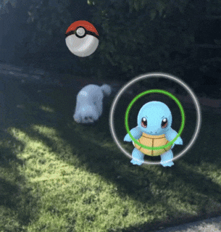
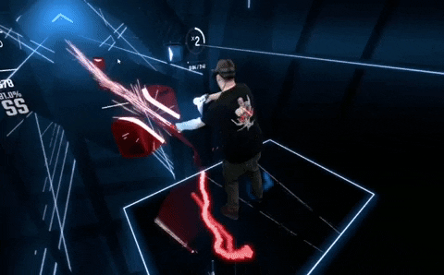
Introduction
Information Visualization
Autumn 2026
Augmented Reality (AR)
Virtual Reality (VR)

Slide 3
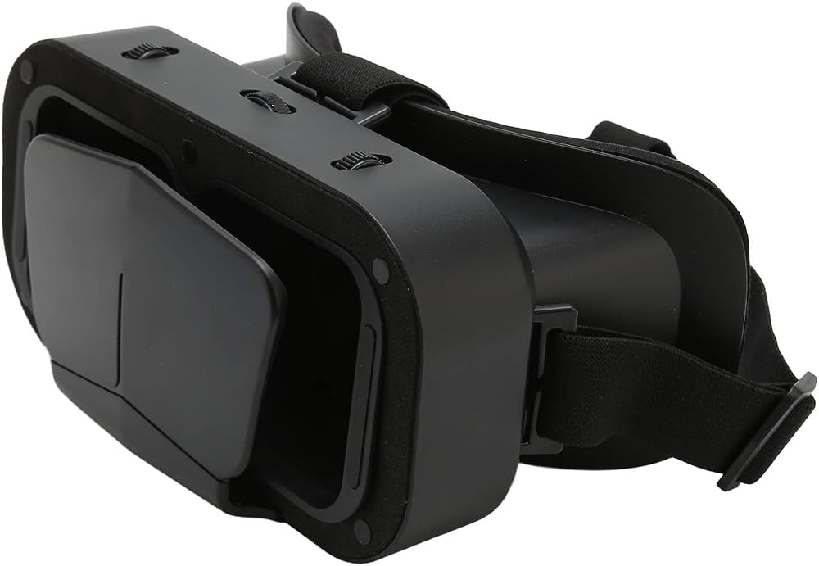
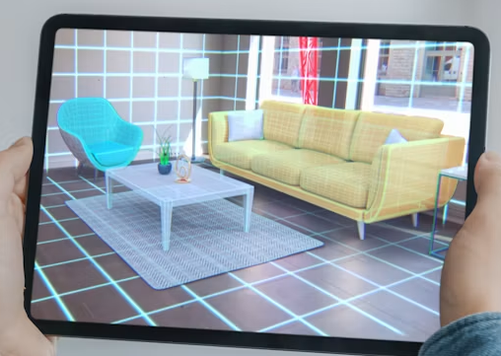
2. Method
Information Visualization
Autumn 2026
182 candidate papers (2013–2020) -> 68 Final Studies (ACM, IEEE, Springer, Elsevier)
DISPLAY
INPUT
Freehand 🤚
Head👤
Speech🗣️
Hardware🎮

Slide 4
2. Method
Information Visualization
Autumn 2026
182 candidate papers (2013–2020) -> 68 Final Studies (ACM, IEEE, Springer, Elsevier)
TASKS EVALUATED
STUDY TYPES
CONTEXT
Pointing
Selection
Translation
Rotation
Scaling
Viewport
Menus
Assessment
Comparison
Elicitation
Lab / Wild
Static / In-motion

Slide 5
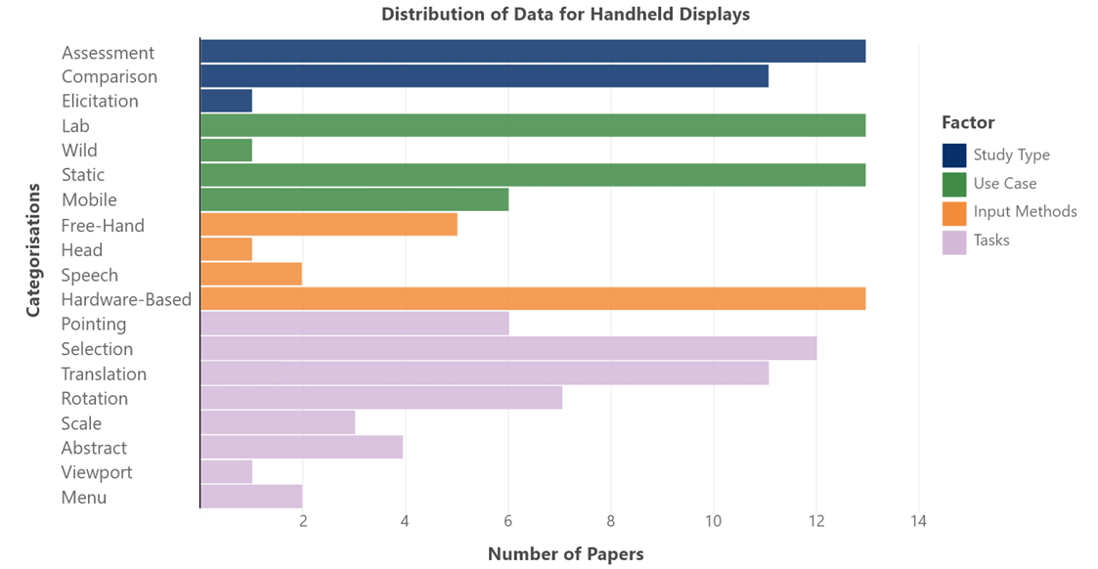
3. Data analysis
Information Visualization
Autumn 2026

Slide 6
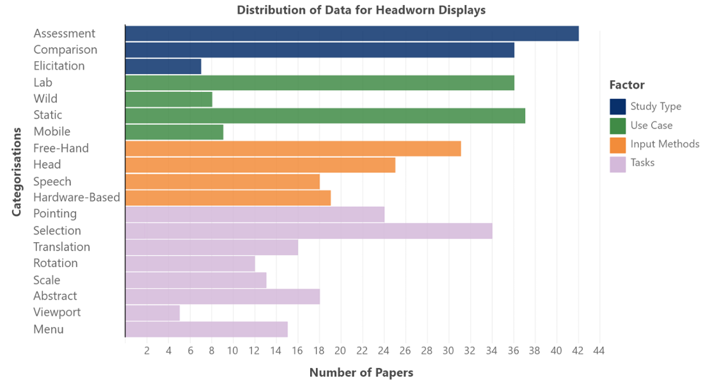
3. Data analysis
Information Visualization
Autumn 2026

Slide 7
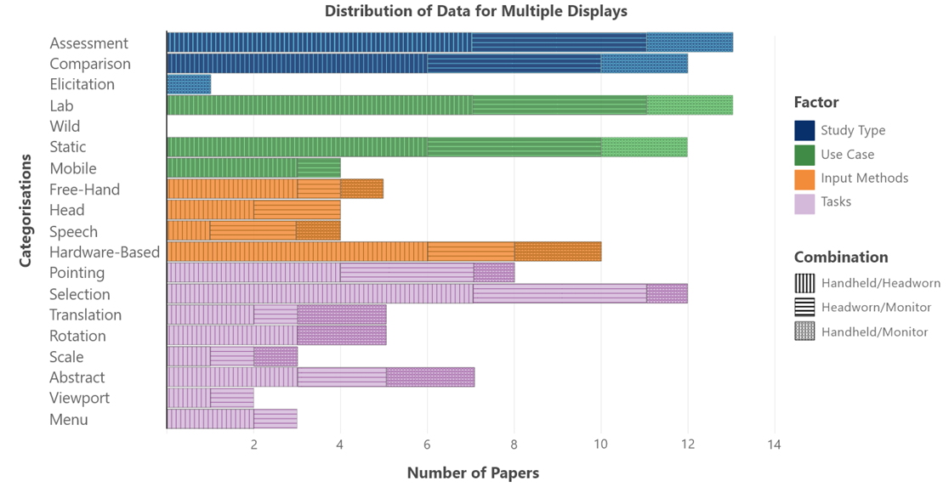
3. Data analysis
Information Visualization
Autumn 2026

Slide 8
General Findings & Conclusions
Pro
Con
Freehand
Intuitive
Gorilla arm
Speech
Great for commands
Poor precision
Head-Based
Hands-free
Learning curve
Multimodal
Improve usability
Complexity
36/68
Combines 2+ input types
Hardware
Fast, precise
Extra gear
Information Visualization
Autumn 2026

Slide 9
Recommendations
Leave the lab
Diverse demographics
Rethink old habits
Information Visualization
Autumn 2026
Lab -> Real-world
Age, gender, culture
2D ≠ 3D space

Slide 10
6.Our opinion
Multimodal is key
No single input wins
Lab-only is a weakness
Real-world testing
Relevant for Developers
Match input to task
Information Visualization
Autumn 2026

Slide 11
Thank you!
Questions?
Jaime Moreno Castellanos & Teresa Martínez Muñoz
Information Visualization
Autumn 2026

